Slide 1

B.E Project Presentation
Department of Computer Engineering
A Final Year Project Presentation On
Domain : Image Processing , ML , Data Science
Presented By :
Mr. Tejas Bhandare (17)
Mr. Rohit Bava (16)
Mr. Ishan Ahirrao (04)
Mr. Namrata Ahire (02)
Final Year Engineering
1

Slide 2
Project Intorduction
Complaint Registration Application for Urban/Rural Areas.
Overview:
The Complaint Registration Application for Urban/Rural Areas, powered by automation technology such as Machine Learning (ML), Data Science, and Image Processing, is an innovative digital platform designed to revolutionize the process of gathering and addressing complaints related to waste material, road path holes, pipelines, drainage systems, and other issues in both urban and rural regions.
2

Slide 3
Objectives
Objectives:
User-friendly Interface.
Automated Issue Detection.
Accurate Geolocation.
Increase Public Engagement.
Real-time Updates.
3

Slide 4
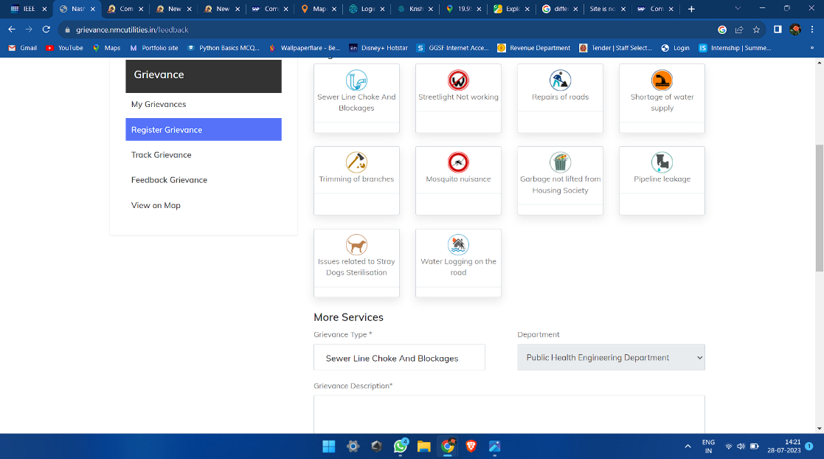
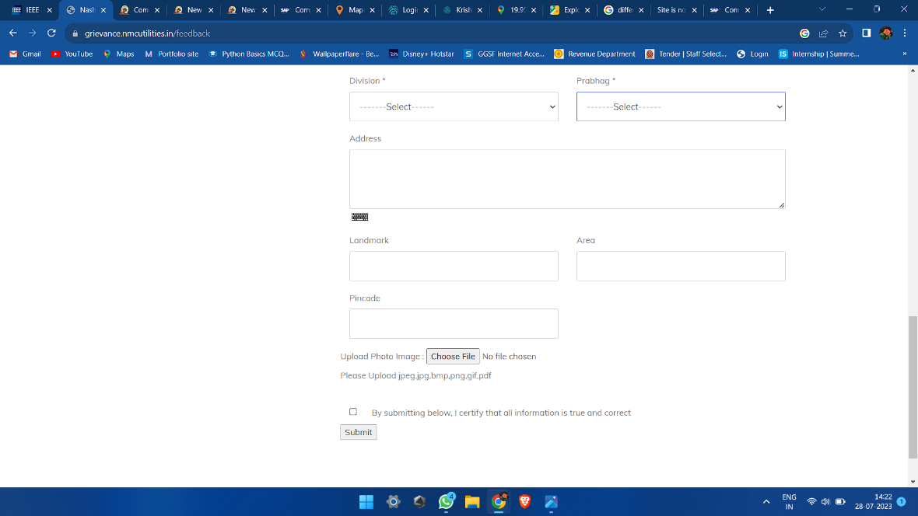
Existing System
1.Nashik Municipal Corporation:
https://grievance.nmcutilities.in/login
4

Slide 5
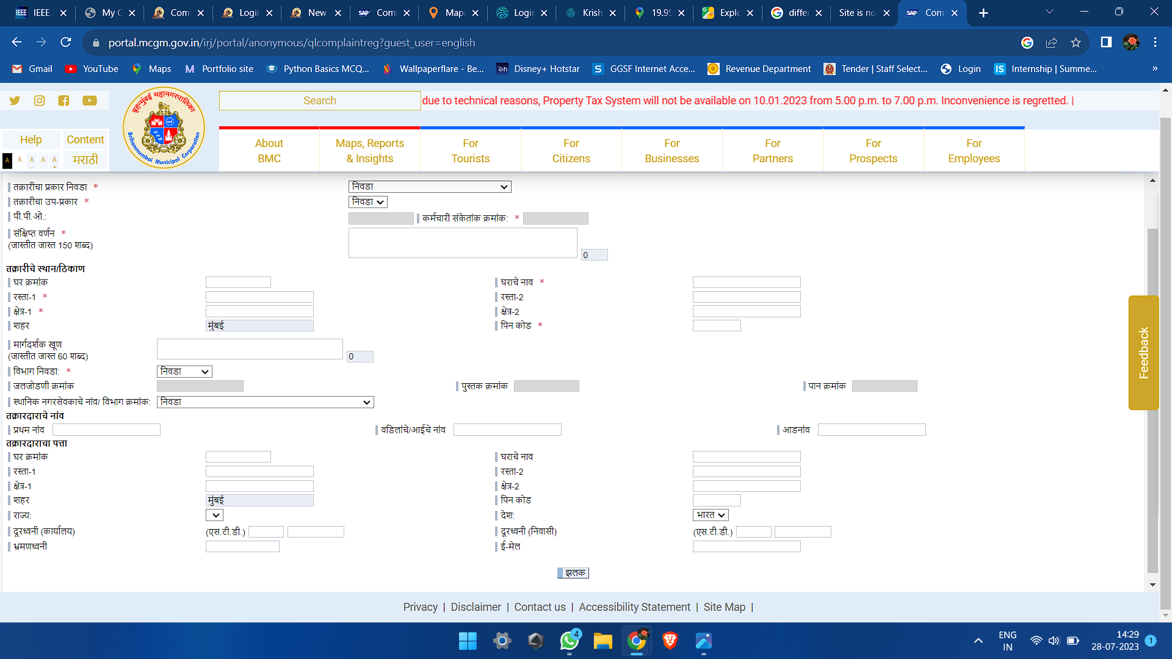
Existing System
1. Pune Municipal Corporation :
https://complaint.pmc.gov.in/logout?user=citizen
2. Mumbai Municipal Corportion:
https://portal.mcgm.gov.in/irj/portal/anonymous/qlcomplaintreg?guest_user=english
5

Slide 6
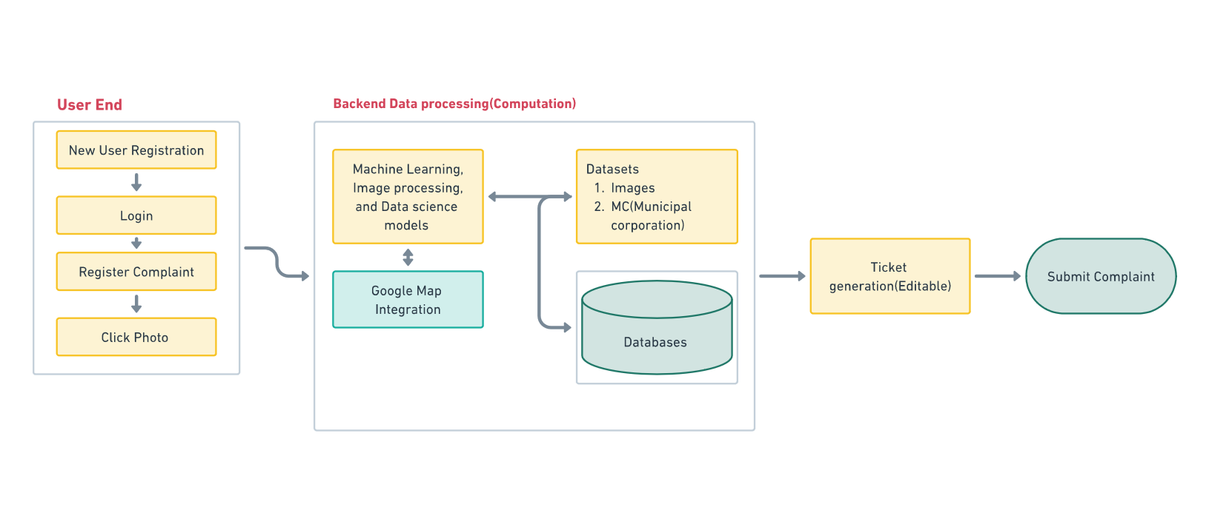
Proposed Architecture
6

Slide 7
Thank You
Any Questions ?
7

